Slide 1
Chapter 3
Chapters
1. Introduction
2. Graphs
3. Descriptive statistics
4. Basic probability
5. Discrete distributions
6. Continuous distributions
7. Central limit theorem
8. Estimation
9. Hypothesis testing
10. Two-sample tests
13. Linear regression
14. Multivariate regression
Numerical Descriptive Techniques
III

Slide 2
Two Variables, Linear Relationship

Slide 3
Measures of Linear Relationship
If we plot variable pairs, how close to a straight line will our plot look?
Two measures providing information as to the strength & direction of a linear relationship between two variables.
Covariance and Correlation Coefficient (called Coefficient of Correlation in textbook).
Covariance - is there any pattern to the way two variables move together?
Correlation Coefficient - how strong is the linear relationship between two variables?

Slide 4
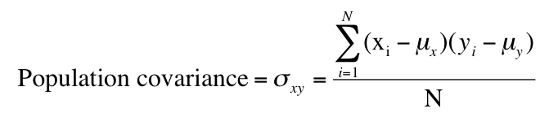
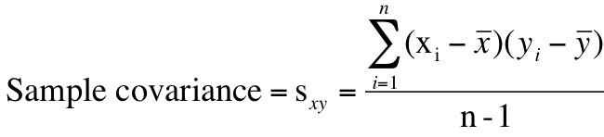
Covariance
population mean of variable X, variable Y
sample mean of variable X, variable Y
Note: divisor is n-1, not n as you may expect.

Slide 5
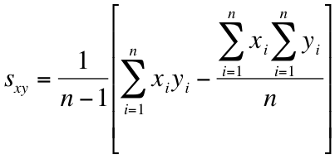
Covariance…
In much the same way there was a “shortcut” for calculating sample variance without having to calculate the sample mean, there is also a shortcut for calculating sample covariance without having to first calculate the mean:

Slide 6
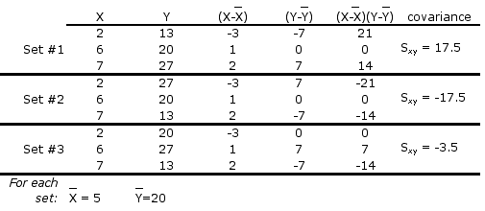
Covariance Illustrated
Consider the following three sets of data: (textbook §4.5)…
In each set, the values of X are the same, and the value for Y are the same; the only thing that’s changed is the order of the Y’s.
In set #1, as X increases so does Y; S_{xy} is large & positive
In set #2, as X increases, Y decreases; S_{xy} is large & negative
In set #3, as X increases, Y doesn’t move in any particular way; S_{xy} is “small”

Slide 7
Y
-
+
17
-
+
13
2
6
7
X

Slide 8
Covariance… (Generally speaking)
When two variables move in the same direction (both increase or both decrease), the covariance will be a large positive number.
When two variables move in opposite directions, the covariance is a large negative number.
When there is no particular pattern, the covariance is a small number.
However, it’s difficult to interpret Covariance.
Units are not meaningful.
Size of covariance depends on the scale of variable, so that the comparison of relative strength is virtually impossible.

Slide 9


Correlation Coefficient
Correlation Coefficient is defined as the covariance divided by the standard deviations of the variables:
Greek letter “rho”
This coefficient answers the question:
How strong is the association between X and Y?

Slide 10






Statistics is a pattern language…
 | Population | Sample
Size | N | n
Mean
Variance |  | S²
Standard Deviation |  | S
Coefficient of Variation | CV | cv
Covariance |  | S_{xy}
Coefficient of Correlation |  | r

Slide 11
Correlation Coefficient
Correlation Coefficient is “standardized” covariance, free of unit.
The advantage of the correlation coefficient over covariance is that it has fixed range from -1 to +1, thus:
If the two variables are very strongly positively related, the coefficient value is close to +1 (strong positive linear relationship).
If the two variables are very strongly negatively related, the coefficient value is close to -1 (strong negative linear relationship).
No straight line relationship is indicated by a coefficient close to zero.

Slide 12
Coefficient of Correlation…
+1
0
-1
Strong positive linear relationship
ρ or r =
No linear relationship
Strong negative linear relationship

Slide 13
Example 4.16
Because we’ve already calculated the covariances we only need compute the standard deviations of X and Y.

Slide 14
Example 4.16
The standard deviations are
The coefficients of correlation are
Set 1:
Set 2:
Set 3:

Slide 15
Excel and Covariance
Both, the excel command
=covar(Array1,Array2) as well as
Covariance in the data analysis toolpak
calculate the population covariance .
To transform the population covariance into the sample covariance adjust by multiplying with N/(n-1):

Slide 16
Correlation Coefficient (Application)
Consider Example 4.16, where MBA grade point averages are compared with GMAT scores. Is the GMAT score a good predictor of MBA success?
This is the population covariance!!
Gmat | GPA
599 | 9.6
689 | 8.8
584 | 7.4
631 | 10
595 | 7.8
643 | 9.2
656 | 9.6
594 | 8.4
710 | 11.2
611 | 7.6
593 | 8.8
683 | 8
Excel:
Tools > Data Analysis… > Covariance
Tools > Data Analysis… > Correlation
 | Gmat | GPA
Gmat | 1733.222
GPA | 23.89444 | 1.148889

Slide 17
GMAT & GPA Interpretation…
 | Gmat | GPA
Gmat | 1733.222
GPA | 23.89444 | 1.148889
 | Gmat | GPA
Gmat | 1
GPA | 0.535465 | 1
The population covariance is 23.89 and the correlation coefficient is .5354.
These two statistics tell us that there is a positive linear relationship between GMAT score and GPA.
The coefficient of correlation tells us that the linear relationship is “moderately” strong.

Slide 18
Least Squares Method
The objective of the scatter diagram is to measure the strength and direction of the linear relationship.
Both can be more easily judged by drawing a straight line through the data.
We need an objective method of producing a straight line.
Such a method has been developed; it is called the least squares method.

Slide 19
Causation
Change in independent variable (explanatory variable) directly causes change in dependent variable (response variable).
If we’ve determined there is a linear relationship between two variables with covariance and the correlation coefficient, can we determine a linear function of the relationship?
If we have good reason to suspect a causal relationship, we can create a model more informative and more powerful than covariance or correlation.

Slide 20
Least Squares Method…
Recall, the slope-intercept equation for a line is expressed in these terms:
y = b1*x + b0
Where:
b1 is the slope of the line
b0 is the y-intercept.
If we’ve determined there is a linear relationship between two variables with covariance and the coefficient of correlation, can we determine a linear function of the relationship?

Slide 21


The Least Squares Method…
…produces a straight line drawn through the points so that the sum of squared deviations between the points and the line is minimized. This line is represented by the equation:
b₀ (“b” naught) is the y-intercept,
b₁ is the slope, and
(“y” hat) is predicted y determined by the line.

Slide 22
Least Squares Line
Line that minimizes the sum of squared deviations from the mean.
Y
Y = b1*X + b0
rise
run
d1^2
d3^2
b1
=slope (=rise/run)
b0
=y-intercept
d2^2
X

Slide 23
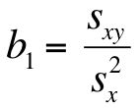

The Least Squares Method…
The coefficients b₀ and b₁ are given by:
Then get the intercept, as:

Slide 24
Least Squares Line…
Find the least squares line for the previous example (e.g. MBA / GMAT).

Slide 25
Least Squares Line…

Slide 26
Example: Fixed and Variable Costs
Fixed costs are costs that must be paid whether or not any units are produced.
These costs are "fixed" over a specified period of time or range of production.
Variable costs are costs that vary directly with the number of products produced.

Slide 27
Fixed and Variable Costs
There are some expenses that are mixed.
There are several ways to break the mixed costs in its fixed and variable components. One such method is the least squares line. That is, we express the total costs of some component as
y = b₀ + b₁x
where y = total mixed cost,
b₀ = fixed cost and
b₁ = variable cost, and
x is the number of units.

Slide 28
Example 4.17
A tool and die maker operates out of a small shop making specialized tools.
He is considering increasing the size of his business and needed to know more about his costs.
One such cost is electricity, which he needs to operate his machines and lights. (Some jobs require that he turn on extra bright lights to illuminate his work.)
He keeps track of his daily electricity costs and the number of tools that he made that day.
Determine the fixed and variable electricity costs.

Slide 29
Example 4.17

Slide 30
Example 4.17
The slope is defined as rise/run, which means that it is the change in y (rise) for a 1-unit increase in x (run).
The slope measures the marginal rate of change in the dependent variable. The marginal rate of change refers to the effect of increasing the independent variable by one additional unit.
In this example the slope is 2.25, which means that for each 1-unit increase in the number of tools, the marginal increase in the electricity cost 2.25.
Thus, the estimated variable cost is $2.25 per tool.

Slide 31
Example 4.17
The y-intercept is 9.59. That is, the line strikes the y-axis at 9.59.
This is simply the value of when x = 0.
However, when x = 0 we are producing no tools and hence the estimated fixed cost of electricity is $9.59 per day.

Slide 32
Coefficient of Determination
When we introduced the coefficient of correlation we pointed out that except for −1, 0, and +1 we cannot precisely interpret its meaning.
We can judge the coefficient of correlation in relation to its proximity to −1, 0, and +1 only.
Fortunately, we have another measure that can be precisely interpreted.
It is the coefficient of determination, which is calculated by squaring the coefficient of correlation. For this reason we denote it R² .
The coefficient of determination measures the amount of variation in the dependent variable that is explained by the variation in the independent variable.

Slide 33
Example 4.18
Calculate the coefficient of determination for Example 4.17

Slide 34
Example 4.18
The coefficient of determination is
R² = .758
This tells us that 75.8% of the variation in electrical costs is explained by the number of tools.
The remaining 24.2% is unexplained.

Slide 35
Interpreting Correlation (or Determination)
Because of its importance we remind you about the correct interpretation of the analysis of the relationship between two interval variables.
That is, if two variables are linearly related it does not mean that X is causing Y.
It may mean that another variable is causing both X and Y or that Y is causing X.
Remember “Correlation is not Causation”

